Slide 1
Description of A/B Testing for a Mobile App
Test Subject: The weekly premium subscription screen.
Groups:
A (control): Existing screen offering a weekly subscription for $4.99.
B (test): Redesigned screen also offering a weekly subscription for $4.99, but presented as a 50% discount.
Goal: To increase the conversion rate to subscription.
Duration: 22 days (03.07. 2023 - 25.07.2023).
Confidence Level: 0.05 (the maximum probability of rejecting the null hypothesis when it is true).
Hypotheses:
H0: The new design has no effect on subscription conversion.
H1: The new design has an effect on subscription conversion.

Slide 2
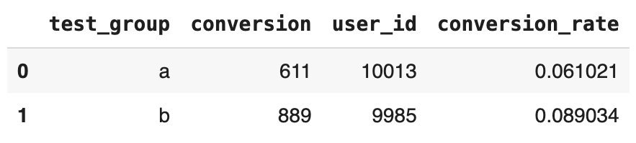
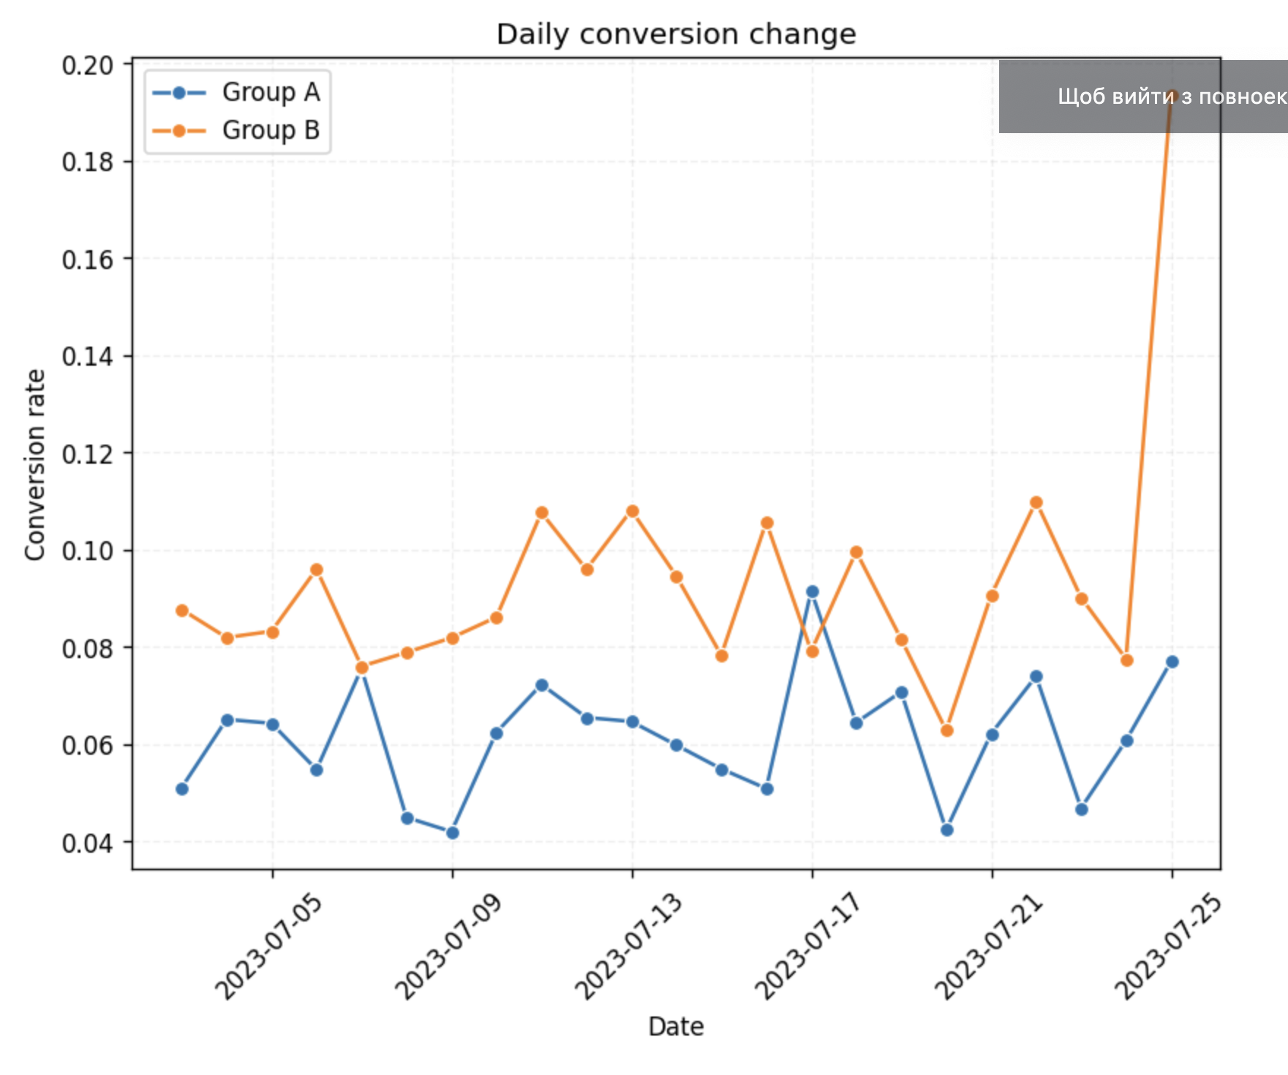
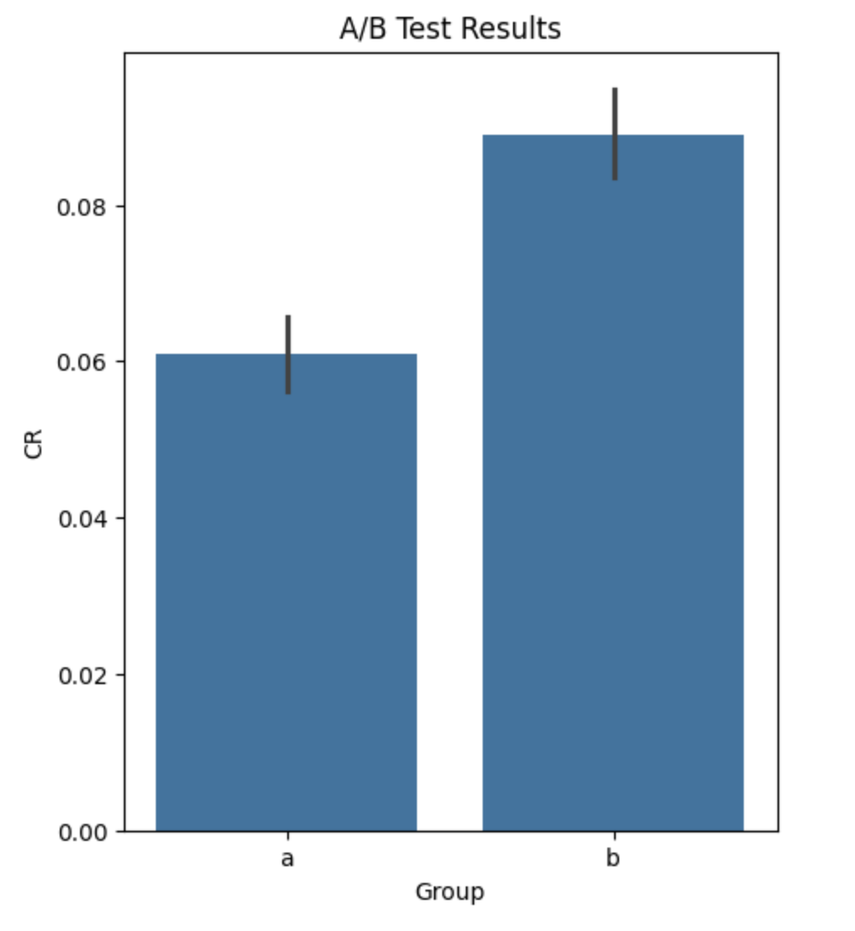
Results of A/B testing
Number of users in group A - 10013
in group B - 9985
Number of conversions in group A - 611
in group B - 889
Conversion rate in group A - 0.06
in group B - 0.09
Start date test - 2023-07-03
End date test - 2023-07-25
Test duration - 23 days
t-statistic: -7.53, p-value: 0.0
The difference is statistically
significant, Null Hypothesis is
rejected.

Slide 3
Conclusions
Showing the weekly subscription as a 50% discount made more people subscribe.
The difference between the old screen and the new screen is statistically significant. This means the discount message likely caused the increase in subscriptions.
The "Daily conversion change" graph shows a big increase in sign-ups for group B at the end of the test. This might be from a special event or promotion.
The subscription rate went up from 6% to 9%. This is a good improvement.
Decision
We will use the new subscription screen with the 50% discount message for everyone.
We will look into why the B group had a big increase in sign-ups at the end of the test.

